Slide 1
Python programming _mini project

Slide 2
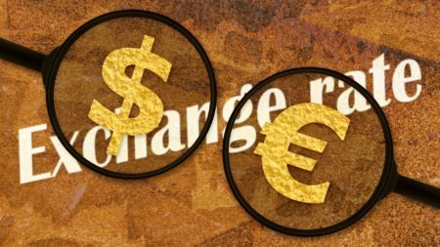
●Project name:- Currency Converter – Python Project with Source Code ●project participants name&Enrollmentno.:- ~komal Birare•197006 ~pragati ghume •197017

Slide 3
Steps to Build the Python Project on Currency Converter ●Real-time Exchange rates ●Import required Libraries ●CurrencyConverter Class ●UI for CurrencyConverter ●Main Function

Slide 4
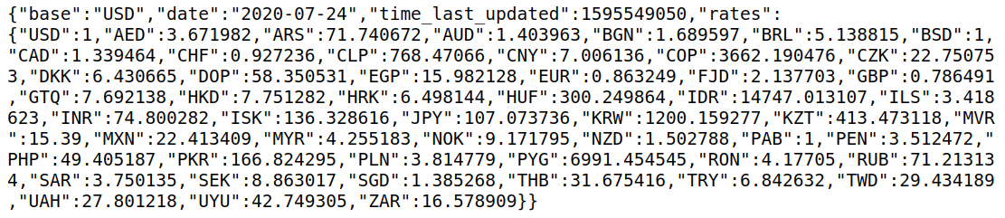
1. Real-time Exchange rates To get real-time exchange rates, we will use: https://api.exchangerate-api.com/v4/latest/USD

Slide 5
Here, we can see the data in JSON format, with the following details:
Base – USD: It means we have our base currency USD. which means to convert any currency we have to first convert it to USD then from USD, we will convert it in whichever currency we want.
Date and time: It shows the last updated date and time.
Rates: It is the exchange rate of currencies with base currency USD.

Slide 6
2. Import the libraries: For this project based on Python, we are using the tkinter and requests library. So we need to import the library. import requests from tkinter import * import tkinter as tk from tkinter import ttk

Slide 7
3. Create the CurrencyConverter class: Now we will create the CurrencyConverter class which will get the real time exchange rate and convert the currency and return the converted amount. 3.1. Let’s create the constructor of class. class CurrencyConverter(): def __init__(self,url): self.data= requests.get(url).json() self.currencies = self.data['rates']

Slide 8
3.2. Convert() method: def convert(self, from_currency, to_currency, amount): initial_amount = amount #first convert it into USD if it is not in USD. # because our base currency is USD if from_currency != 'USD' : amount = amount / self.currencies[from_currency] # limiting the precision to 4 decimal places

Slide 9
amount = round(amount * self.currencies[to_currency], 4) return amount

Slide 10
This method takes following arguments: From_currency: currency from which you want to convert. to _currency: currency in which you want to convert. Amount: how much amount you want to convert. And returns the converted amount.

Slide 11
Example url= 'https://api.exchangerate-api.com/v4/latest/USD' converter = CurrencyConverter(url) print(converter.convert('INR','USD',
OUTPUT: 1.33
100 Indian rupees = 1.33 US dollars

Slide 12
4. Now let’s create a UI for the currency converter To Create UI we will create a class CurrencyConverterUI def __init__(self, converter): tk.Tk.__init__(self) self.title = 'Currency Converter' self.currency_converter = converter Converter: Currency Converter object which we will use to convert currencies. Above code will create a Frame.

Slide 13
Let’s Create the Converter
self.geometry("500x200") #Label self.intro_label = Label(self, text = 'Welcome to Real Time Currency Convertor', fg = 'blue', relief = tk.RAISED, borderwidth = 3) self.intro_label.config(font = ('Courier',15,'bold')) self.date_label = Label(self, text = f"1 Indian Rupee equals = {self.currency_converter.convert('INR','USD',1)} USD \n Date : {self.currency_converter.data['date']}", relief = tk.GROOVE, borderwidth = 5) self.intro_label.place(x = 10 , y = 5) self.date_label.place(x = 170, y= 50)

Slide 14
Currency Converter using Python
A currency is a system of money in common use, especially for people in a nation, eg, INR, USD and Bitcoin (₿) is a cryptocurrency. In this Blog article, we will learn how to Create Currency Converter. We will see the implementation in Python.
What is BitCoin?
What is Currency?
Basics of forex-python Module
Create Currency Converter using python

Slide 15
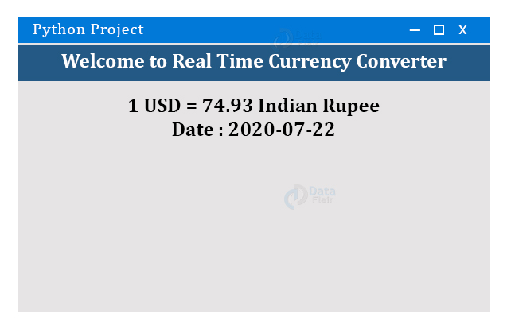
NOTE: This Code part of __init__ method. First, we set up the frame and add some info in it. After the execution of this part of code, our frame looks like something.

Slide 16
5. Let’s create the main function. First, we will create the Converter. Second, Create the UI for Converter

Slide 17
if __name__ == '__main__': url = 'https://api.exchangerate-api.com/v4/latest/USD' converter = RealTimeCurrencyConverter(url) App(converter) mainloop()

Slide 18
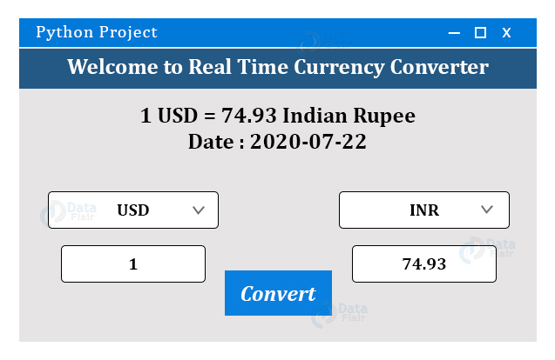

Slide 19
Let's get started!
What is BitCoin?:
Bitcoin is a cryptocurrency,an innovative payment network, invented in 2008 by an unknown person or group of people using the name Satoshi Nakamoto and started in 2009.
What is Currency?:
Currency is a medium of exchange for goods and services. In short, it's money, in the form of paper or coins, usually issued by a government and generally accepted at its face value as a method of payment.

Slide 20
Module Used: forex-python Module: Forex Python is a Free Foreign exchange rates and currency conversion. Features: ●List all currency rates. ●BitCoin price for all curuncies. ●Converting amount to BitCoins. ●Get historical rates for any day since 1999.

Slide 21
●Conversion rate for one currency(ex; USD to INR). ●Convert amount from one currency to other.(‘USD 10$’ to INR). ●Currency symbols, Currency names, etc.
Now that you are familiar with BitCoin and Currency and have acquired basic knowledge of forex-python module, we can move forward to the coding section.

Slide 22
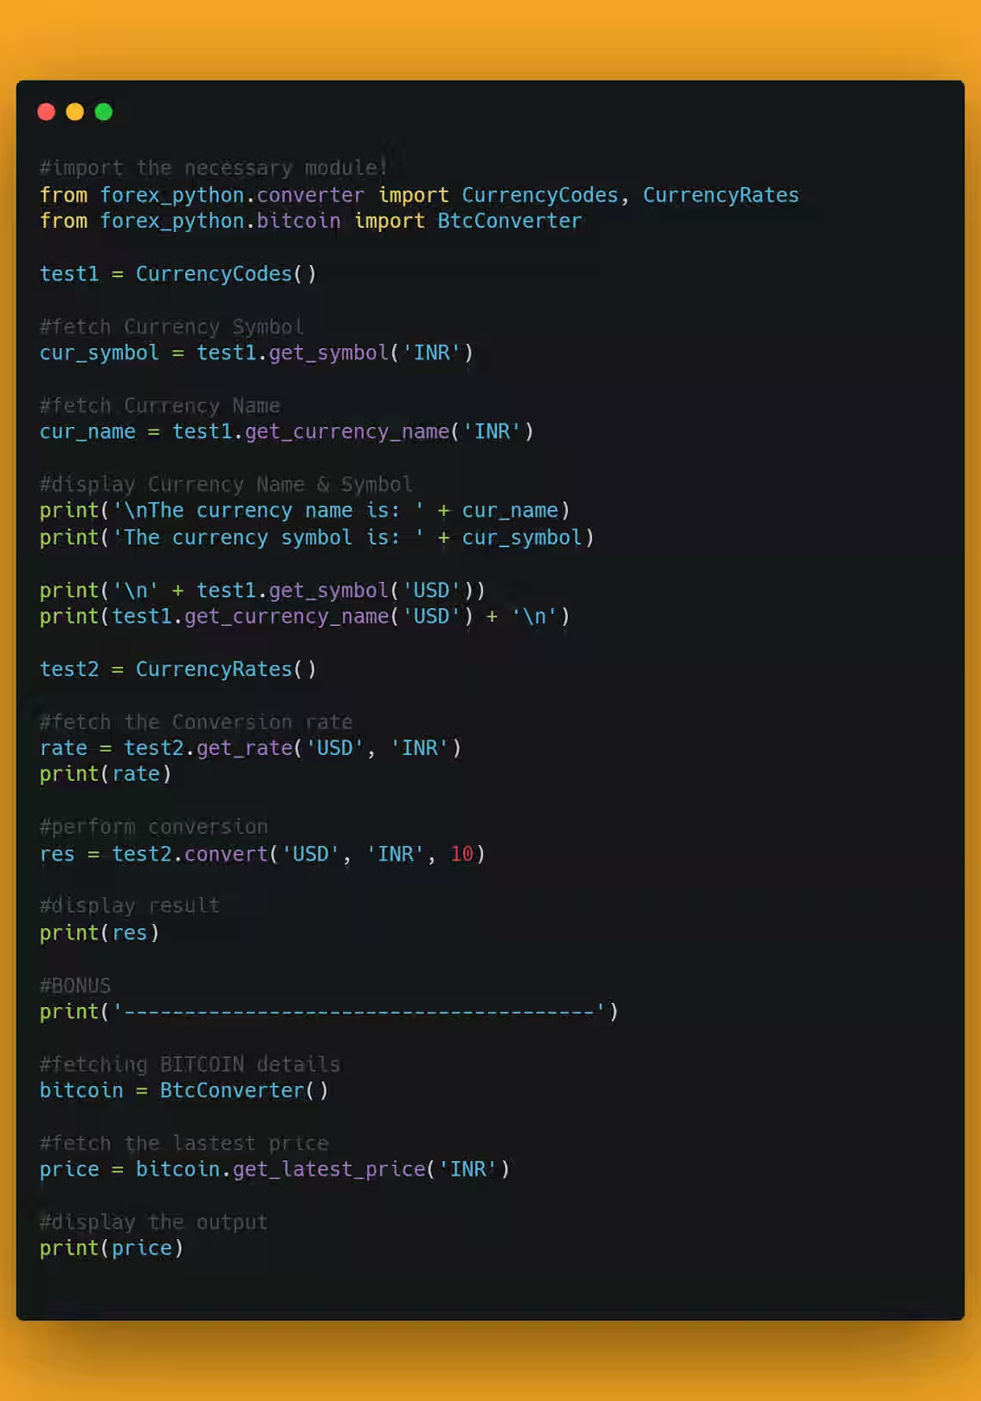
Time to Code!
You can find all the code at my GitHub Repository. Drop a star if you find it useful.

Slide 23
pip install forex-python
In order to access the Python library, you need to install it into your Python environment

Slide 24
from forex_python.converter import CurrencyCodes, CurrencyRates from forex_python.bitcoin import BtcConverter
Now, we need to import the package in our python script. Use the following do to so.

Slide 25
test1 = CurrencyCodes()
Let's create an instance of CurrencyCodes. I am naming it as test1.

Slide 26
cur_symbol = test1.get_symbol('INR')
Once done, let's fetch the currency symbol. I am making use of get_symbol method for the same and passing the currency code as a parameter. Let's store it in cur_symbol.
cur_symbol = test1.get_symbol('INR')

Slide 27
cur_name = test1.get_currency_name('INR')
Let's fetch the currency name. I am making use of get_currency_name method for the same and passing the currency code as a parameter. Let's store it in cur_name.

Slide 28
Let's display the output.
print('The currency name is: ' + cur_name) print('The currency symbol is: ' + cur_symbol) #let's see for another example print('\n' + test1.get_symbol('USD')) print(test1.get_currency_name('USD’))
#OUTPUT: The currency name is: Indian rupee The currency symbol is: ₹ US$ United States dollar

Slide 29
test2 = CurrencyRates()
Now, let's move forward and create an instance for CurrencyRates.

Slide 30
rate = test2.get_rate('USD', 'INR') print(rate) #OUTPUT: 73.6702434998
Once done, let's fetch the Conversion rate. I will make use of get_rate method for the same. Let's fetch what 1 United States Dollar equals-to in Indian rupee.

Slide 31
res = test2.convert('USD', 'INR', 10) print(res) #OUTPUT: 736.702434998
Now that we have successfully fetched the conversion rate, let's try converting 10 US$ to Indian rupee. I will make use of convert method for the same.

Slide 32
I am passing three parameters here, ●original currency ●the converted currency ●conversion amount

Slide 33
Let's fetch BITCOIN's latest price details. Let's start by creating an instance of BtcConverter
bitcoin = BtcConverter()

Slide 34
price = bitcoin.get_latest_price('INR') #display the output print(price)
Now, let's fetch the latest price, I will make use of get_latest_price method for the same. Finally, you can printout the result.

Slide 35
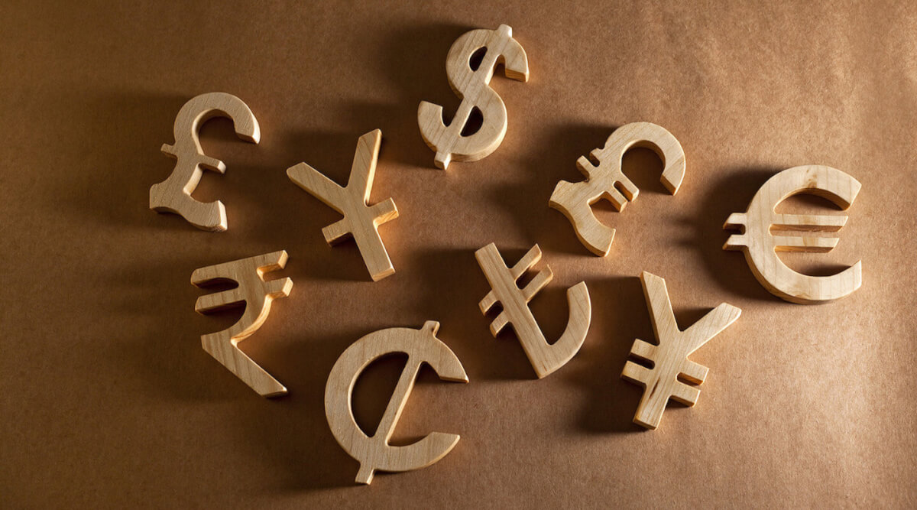
With these steps, we have successfully Created Currency Converter using python. That's it!

Slide 36
You can play around with the forex-python library and even explore more features. You can even make use of Python GUI using Tkinter.

Slide 37
Conclusion: in this mini project we worked on the Python project to build a Currency Converter.

Slide 38

Thank you

